Slide 1
Summer Assignment Review
What’s the big deal?
The basis of living organisms, and the heritable information they contain, is a collection of atoms and molecules linked together by chemical bonds that are organized in a hierarchy of structural levels that require constant input of energy.
Pages 1-4 are meant to help highlight the important information included in each unit. While this can be a major source of information, make sure to use any/all studying tools available to you (ie class notes, textbook, videos, supplemental study books, etc.) Please note that while the College Board lays out the topics in this order, the class may go through the topics in a different order or combine similar topics.
Topic 01: Biology Review and an Introduction to Statistics
Learning Objective To review the basic concepts of biology. | Vocabulary/Review Questions What is the difference between inductive and deductive reasoning? What is the difference between a theory and a law? Can a theory become a law? How are hypotheses formulated? What is the difference between null and alternative hypotheses? Do you always need both? How do researchers determine their independent and dependent variables? How are they often graphed (ie what is on the x-axis what is on the y-axis)? Are constants the same as controls? Why or why not? When should a positive control be used? When should a negative control be used? What types of data can be collected in an experiment? Give an explanation of each. Describe central tendencies. Identify when each type of central tendency should be used. What is used to measure variability? Is data more reliable with low or high standard deviation? Why? Why do researchers use SEM? If error bars overlap, is the data significantly different? Why or why not?
Essential Knowledge Identify or pose a testable question based on an observation, data, or a model. State the null and alternative hypotheses, or predict the results of an experiment. Identify experimental procedures that are aligned to the question, including: Identifying dependent and independent variables. Identifying appropriate controls. Justifying appropriate controls. Support a claim with evidence from biological principles, concepts, processes, and/or data. Provide reasoning to justify a claim by connecting evidence to biological theories. Explain the relationship between experimental results and larger biological concepts, processes, or theories. Construct a graph, plot, or chart. Describe data from a table or graph, including: Identifying specific data points. Describing trends and/or patterns in the data. Describing relationships between variables. Perform mathematical calculations. Use confidence intervals and/or error bars (both determined using standard errors) to determine whether sample means are statistically different.
Hypothesis | Theory | Inductive reasoning | Experimental group
Scientific Law | Control group | Deductive reasoning | Independent variable
Constants | Alternative hypothesis | Null hypothesis | Dependent variable
Mean | Median | Central tendencies | Mode
Variability | Range | Standard deviation | Standard error of the mean

Slide 2
Topic 01: Biology Review
Science
At the heart of science is _________________
Inquiry:
Two main steps:
Making Observations
Describes natural structures and processes through _____________________ and ____________________ of data
Data:
Qualitative:
Quantitative:
Inductive reasoning:
Forming Hypotheses
Hypothesis:
Results can either __________________ or __________________ the hypothesis
NEVER SAY
Deductive reasoning:
Questions?
Textbook chapters/pages to review

Slide 3
Concept Check
Read the statements below. Decide whether each statement represents inductive or deductive reasoning.
Every test has been easy, therefore the final will be easy. ___________________________________
All athletes work out. John is an athlete. Therefore, John works out.__________________________
All organisms are made of cells, based on years of research._________________________________
All organisms are made of cells. Dogs are organisms. Dogs are made of cells.____________________
Null and Alternative Hypotheses
Always start with a ___________________________________
Example null hypothesis statements:
After the null, list the ____________________________________
Example alternative hypotheses:
Concept Check
Read the question below. Formulate one null and one alternative hypothesis.
Does the use of nitrogen-based fertilizer in soil affect the growth of sunflowers?
H₀:
H₁:
Questions?
Textbook chapters/pages to review

Slide 4
Practice
Read and answer the questions below using the space provided.
Are teenagers better at geometry than adults? Formulate one null (H₀ ) and one alternative (H₁ ) hypothesis.
Does ivy grow better in areas with more sun versus in shady areas? Formulate one null (H₀ ) and one alternative (H₁ ) hypothesis.
A group of students are interested in examining the potential effects of caffeine (from soda) on heart rate. One group of students hypothesizes that soda consumption will not have an effect on heart rate, while another group proposed an alternative hypothesis that soda consumption will increase heart rate. What data would be expected if the alternative hypothesis was supported?
A researcher suggests that small doses of hyaluronic acid (HA) will promote the uptake of water in human skin, thus reducing symptoms of dryness and dehydration. He suggests that HA binds to water and prevents it from evaporating off of the skin. The researcher creates a skin cream formulated with HA and compares the skin of 100 people before and after use of the cream. Formulate one null (H₀ ) and one alternative (H₁ ) hypothesis. Describe the data you would expect to see that would support the null hypothesis.
Questions?
Textbook chapters/pages to review

Slide 5
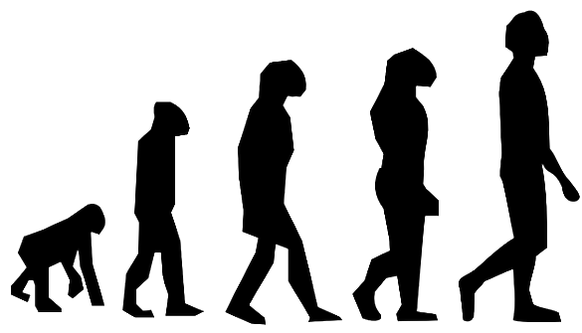
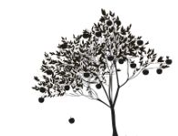
Scientific Method
Most scientific inquiries do not follow a perfectly structured form
Scientists can be working with the wrong hypothesis and have to ____________________________
Hypothesis vs Theory vs Law
Hypothesis Theory Scientific Law
How does each picture above represent its corresponding term?
Questions?
Textbook chapters/pages to review

Slide 6
Experiments
Start with an _____________________ and a ______________________
Use ___________________________________ and _______________________ groups
Well designed experiments should include:
Variables vs Constants
Independent variable:
Dependent variable:
Constants:
Questions?
Textbook chapters/pages to review

Slide 7
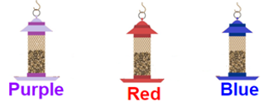
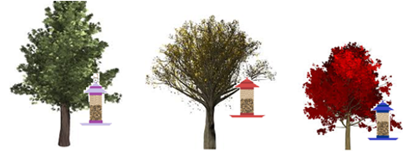
Concept Check
Read the problem below and identify the independent and dependent variables.
You are washing cars to earn money. For each car you wash, you earn $10.
You are interested in how stress affects heart rate in humans. You place humans under different levels of physical stress and measure their heart rate.
A researcher is studying warning calls in a rare species of birds native to South America. The researcher is interested in the reactions of surrounding birds when the warning call is given.
A scientist believes that fish can swim faster in warmer water versus in cooler water.
Read the problem below describing an experimental set-up. Identify what was done incorrectly in the experiment.
You want to design an experiment to see if birds will choose feeders based on color. You choose 3 colors for the bird feeders.
Next, you put the bird feeders outside in trees like so:
Then you record the total number of birds that visit each feeder from 8am to 11am for three days straight. You average the number of birds at each feeder over the three days to determine if there was a color preference of the birds.
Questions?
Textbook chapters/pages to review

Slide 8
Experimental Controls
Control Groups
Controls are essential elements of an experiment:
They help eliminate experimental ________________ and ___________________ of researchers
Results of the control experiments _____________________ statistical analysis of the experiment
Note:
Types of Control Groups
There are two types of controls: _____________________ and ____________________ ________________________ ________________________
Questions?
Textbook chapters/pages to review

Slide 9
Using Positive Controls
Example: If there is a new drug to treat headaches, Tylenol can be used as a positive control to show that headaches can be relieved in the patients being tested.
Practice
Example: A researcher wants to test the effect of a new antibiotic on a strain of bacteria.
How would the researcher know the new antibiotic (experimental group) is actually effective?
Using Negative Controls
A negative control can be a way of setting a ____________________
Example: If there is a new drug to treat headaches, a placebo can be used as a negative control.
Practice
Example: A researcher wants to test the effect of caffeine on heart rate.
Researcher will give the negative control group a treatment that is known to have no effect on heart rate.
Questions?
Textbook chapters/pages to review

Slide 10
Practice
You want to design an experiment to determine if a new drug has an impact on lowering blood pressure. Test subjects with high blood pressure are given a new medication in pill form. The percentage of patients whose blood pressure decreased is measured. What are good positive and negative controls?
You believe that when someone drinks a soda, their heart rate will increase. You set up an experiment, using various sodas, and various amounts of consumption and then measure the heart rate of the individuals. What are good positive and negative controls?
Proper soil composition is important for plants. Some elements, like nitrogen, are known to increase plant growth. A researcher wants to develop a soil with added minerals and nutrients to determine the best composition to promote healthy plant growth. What are good positive and negative controls?
Approximately 10% of people living in the United States are allergic to penicillin. A research team has developed a new antibiotic that could potentially replace penicillin and treat a wide variety of bacterial infections. To test their theory, the scientists grow Streptococcus pyogenes in petri dishes. S. pyogenes causes numerous infections in humans, like pharyngitis, tonsillitis, and scarlet fever. These diseases are normally treated successfully with penicillin. They expose S. pyogenes to their new strain of antibiotic to determine its effectiveness. What are good positive and negative controls?
Questions?
Textbook chapters/pages to review

Slide 11
Putting it all Together
You want to design an experiment to see if birds will choose feeders based on color. You choose 3 colors for the bird feeders: purple, red, and blue. With this statement, fill in the following blanks:
Hypotheses:
Null (H₀) hypothesis:
First alternative (H₁) hypothesis:
Second alternative (H₂) hypothesis:
Third alternative (H₃) hypothesis:
Variables:
Independent variable:
Dependent variable:
Constants and controls:
Constants (list as many that you can think of):
Controls (negative/positive):
Questions?
Textbook chapters/pages to review

Slide 12
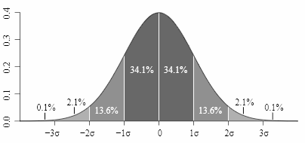
Introduction to Statistics in AP Biology
Statistics
Scientists typically collect data on a _________________ of a population
The first step in analysis is to ___________ the data and examine the _________________________
Typical data will show ____________________________
Measures of Central Tendencies
Questions?
Textbook chapters/pages to review

Slide 13
Mean:
To solve:
Practice problem:
Students in a biology class planted five tomato seeds in separate containers. They exposed the seeds to an artificial light source for twenty days. At the end of the twenty days, the students measured the height of the tomato plants that grew from those seeds. The data is below. What is the mean of the data? Box your answer.
Show work here:
Median:
To solve:
Practice problem:
A group of labrador retrievers is training for the police academy. One test is the “sniff” test, where police officers time how long it takes the dogs find a scent. They collected the data on a group of nine dogs. The data is in the table below. What is the median? Box your answer.
Show work here:
Plant # | 1 | 2 | 3 | 4 | 5
Height (mm) | 65 | 52 | 71 | 56 | 61
Dog | 1 | 2 | 3 | 4 | 5 | 6 | 7 | 8 | 9
Time (s) | 45 | 21 | 48 | 47 | 130 | 55 | 62 | 180 | 41
Questions?
Textbook chapters/pages to review

Slide 14
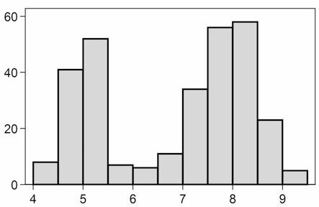
Mode:
Practice Problem
1. Researchers are interested in how long students spend on the TikTok app per day. They take a random sample of 10 high school students who use an iPhone. They examine the amount of time each student spends on TikTok by looking at their screen time for one whole day. The data is below:
For this data set determine the mean, median, and mode. Then identify which measure of central tendency would be most accurate for this data set. Show your work in the space below and write your answers on the lines provided.
Mean: _________________
Median: ________________
Mode: _________________
Which measure of central tendency is most accurate for this data set? Why?
Student | 1 | 2 | 3 | 4 | 5 | 6 | 7 | 8 | 9 | 10
Time (min/day) | 10 | 55 | 85 | 25 | 44 | 37 | 42 | 201 | 56 | 59
Questions?
Textbook chapters/pages to review

Slide 15
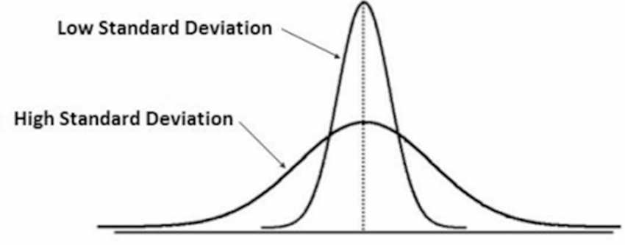
Measure of Variability
Variability:
Range:
Larger range =
Smaller range =
Often used in conjunction with _______________________________________
Let’s look back at the data for the tomato plants. What is the range? Box your answer. Show work here:
Standard deviation:
Low standard deviation:
High standard deviation:
Plant # | 1 | 2 | 3 | 4 | 5
Height (mm) | 65 | 52 | 71 | 56 | 61
Questions?
Textbook chapters/pages to review

Slide 16
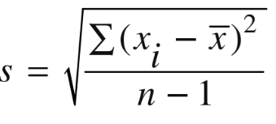
______ standard deviation from the mean in either direction on the horizontal axis represents_______ of the data
______ standard deviations from the mean in either direction on the horizontal axis represents_______ of the data
______ standard deviations from the mean in either direction on the horizontal axis represents_______ of the data
Standard deviation formula:
There are four steps to solve for the standard deviation:
Step 1:
Step 2:
Step 3:
Step 4:
Questions?
Textbook chapters/pages to review

Slide 17
Example: Let’s use the data from the tomato plant experiment
What does this mean?
Mean: ______
Standard deviation (s): _______
1 s would be ________________ (or _________ through _________)
_______ of the data should fall between _________ and _________
2 s would be ________________ (or _________ through _________)
_______ of the data should fall between _________ and _________
3 s would be ________________ (or _________ through _________)
_______ of the data should fall between _________ and _________
Plant | Height (mm)
1 | 65
2 | 52
3 | 71
4 | 56
5 | 61
Questions?
Textbook chapters/pages to review

Slide 18
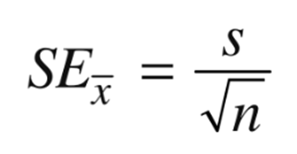
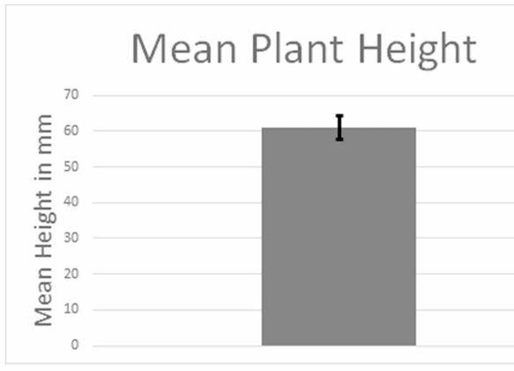
Standard Error of the Mean
Standard error of the mean:
Based on:
Low standard error =
Commonly given as _____________ SEM ( ________ confidence)
Formula:
Standard Error Practice
Let’s use the data we calculated for the tomato plant experiment:
Standard deviation: _________
Sample size: ________
SE_{X}= ______________
This means that each measurement varies by +/- __________ from the mean
Error Bars
Questions?
Textbook chapters/pages to review

Slide 19
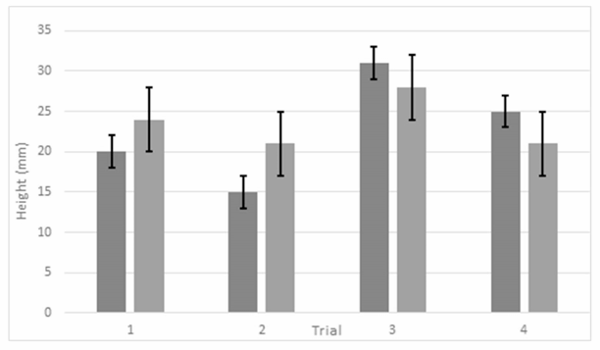
Analyzing Error Bars
Go back to page 18-19 and complete the post-lab for the DYOE.
Use this space to reflect on topic 01
Textbook chapters/pages to review

Slide 20
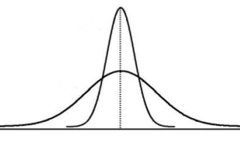
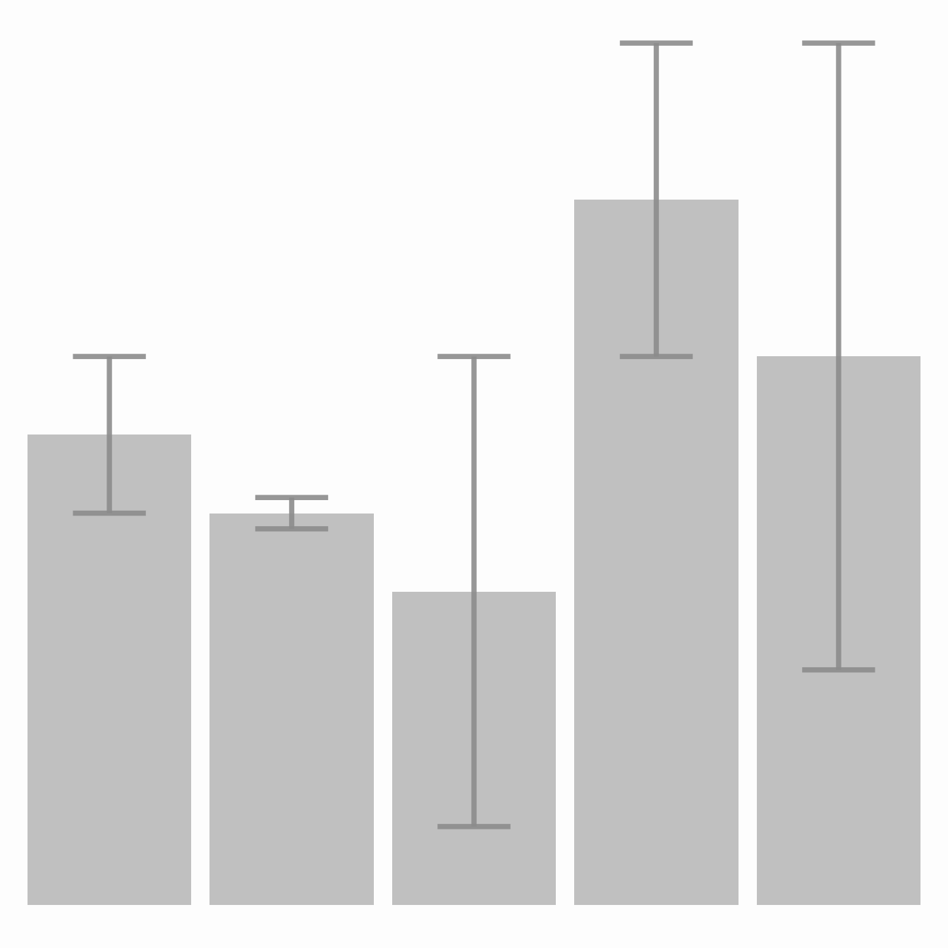
Statistics Practice Problems Part 1
Central Tendencies and Variability
Examine the formula for standard deviation. Identify the following:
The variable x_{i}: ____________________________________________________
The variable : ____________________________________________________
The variable ∑: ____________________________________________________
The variable n: _____________________________________________________
The expression n-1: _________________________________________________
Describe standard deviation in your own words.
Examine the graph below showing two data sets, each with the same mean, but one with a low standard deviation and one with a high standard deviation. Label the one with a high standard deviation as A and the one with a low standard deviation as B. Then explain how you were able to determine this.
Examine the formula for standard error of the mean. Identify the following:
The variable s: ____________________________________________________
The variable n : ____________________________________________________
Describe standard error in your own words. Why is it commonly given/shown as +/- 2 SEM?
Look at the bar graph below. Identify and label the bar with the lowest standard error as A and the bar with the highest standard error as B.

Slide 21
Directions: Examine the data sets given in the problems below and answer their corresponding questions.
The University of Texas is interested in determining the average number of hours of sleep a pre-med major gets each night. They surveyed eight random individuals. The data is shown below:
Calculate the mean number of hours of sleep for this data set.
Calculate the standard deviation for this data set.
Calculate the standard error of the mean for this data set.
Use the space provided to make a bar graph for the mean number of hours slept and include an error bar.
Harvard heard about the study being conducted by the University of Texas and decided to replicate it. The data is shown below. Without doing calculations, predict whether the data gathered by Harvard will have a higher or lower standard deviation than that of the University of Texas. Why?
Now calculate the standard deviation for the data gathered by Harvard. Does it match your prediction?
Individual | A | B | C | D | E | F | G | H
# of hours they slept the previous night | 6 | 4 | 7 | 7 | 6 | 5 | 7 | 6
Individual | A | B | C | D | E | F | G | H
# of hours they slept the previous night | 3 | 5 | 7 | 8 | 6 | 11 | 2 | 12

Slide 22
An athletic trainer is worried that the athletes he works with are not consuming enough water per day, so he sends out a survey. The athletes were asked to record how many ounces of water they consumed over the course of one full day. The data for seven athletes is below:
Calculate the mean for ounces of water consumed by the athletes.
Calculate the standard deviation for this data set.
Calculate the standard error of the mean for this data set.
Use the space provided to make a bar graph for the mean and include an error bar.
You are comparing three data sets, each with the same standard deviation of 2.3. The only difference between the data sets is the sample size (n). Data set 1 has a sample size of 15, data set 2 has a sample size of 30, and data set 3 has a sample size of 45. Calculate the standard error for each data set.
Data set 1:_________________
Data set 2:_________________
Data set 3:_________________
Referring to question 3, what happened to the standard error when the sample size (n) was increased? Use the formula to justify why this happened.
Individual | A | B | C | D | E | F | G
Ounces of water consumed | 51 | 48 | 75 | 30 | 22 | 44 | 70

Slide 23
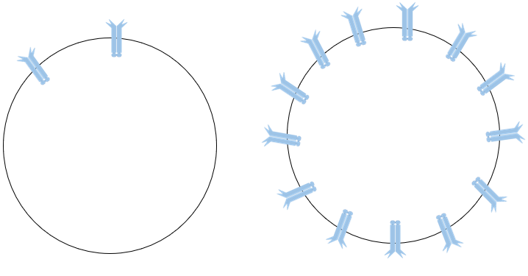
Statistics Practice Problems Part 2
Understanding the Importance of Controls and Statistics When Analyzing Data
A researcher developed a new drug, Herceptin, that has shown promise in treating HER2-positive breast cancer. Approximately 10-20% of breast cancer cells test positive for a protein called HER2 on the surface of the cancer cell. This protein plays a pivotal role in the growth of the cancer cell. Cancer cells are cells that grow rapidly and do not follow the normal cell division pathway, thus forming tumors. Examine the image below and then answer the questions.
How does the cancer cell differ from the normal cell? What effect does this difference have?
In laboratory testing using a HER2-positive breast cancer cell line, the researcher has seen early success with the new treatment. In the lab, the researcher incubated the HER2-positive cell line in a petri dish. After the cells had time to grow, they were treated with a dose of Herceptin. The number of cells that had undergone apoptosis, or cell death, was then examined to determine the effectiveness of the treatment. Examine the data collected below then calculate the mean. Go to the next page to finish formatting the graph, then add the mean that you calculated as a bar to the graph. (*note: we will be adding more to the graph as you progress through the questions).
Next, the researcher wanted to determine how Herceptin compared to another new drug known as Perjeta. The researcher repeated the same process as above, except this time the researcher treated the cells with Perjeta. Examine the data collected below then calculate the mean and add that as a bar to the graph on the next page.
HER2 receptor protein
HER2 receptor protein
Normal cell
Cancer cell
Herceptin Alone
Trial: | 1 | 2 | 3 | 4
% Apoptotic Cells | 22 | 10 | 8 | 25
Perjeta Alone
Trial: | 1 | 2 | 3 | 4
% Apoptotic Cells | 30 | 12 | 20 | 32

Slide 24
Look at the bars that you added for Herceptin and Perjeta. How would you interpret this data?
Go back to questions 2 and 3 and calculate the standard deviation and standard error of the mean for each.
Add error bars (using +/- 2 standard error) to the Herceptin and Perjeta bars. Does this change your interpretation from question 4? Are Herceptin and Perjeta statistically significantly different?
40-
38-
36-
34-
32-
30-
28-
26-
24-
22-
20-
18-
16-
14-
12-
10-
8-
6-
4-
2-
Negative Control
Positive Control
Herceptin
Perjeta
The researcher performed the same experimental set-up with both positive and negative control groups (simultaneous to the experimental groups). For the negative control, the researcher incubated HER2-positive cancer cells in a petri dish with no treatment and then recorded the number of cells that had undergone apoptosis. For the positive control, the researcher used a radiation treatment known to be successful in killing HER2-positive cancer cells. The researcher incubated the HER2-positive cells, then exposed them to radiation and then recorded the number of cells that had undergone apoptosis. Examine the data collected below and then calculate the mean. Add the mean for each to the graph.
Trial: | 1 | 2 | 3 | 4
% Apoptotic Cells in Negative Control | 5 | 4 | 8 | 8
% Apoptotic Cells in Positive Control | 30 | 23 | 40 | 27

Slide 25
Compare Herceptin and Perjeta to the positive control (prior to adding error bars). Describe whether either treatment seems as effective as the positive control?
Compare Herceptin and Perjeta to the negative control (prior to adding error bars). Describe whether either treatment seems effective in comparison to the negative control.
Go back to question 7 and calculate the standard deviation and standard error for both the positive and negative control groups. Add their error bars (using +/- 2 standard error) to their corresponding bars on the graph.
Now that you added error bars, compare Herceptin and Perjeta to the positive control again. Is either treatment statistically significantly different (in terms of effectiveness) from the positive control? If so, how?
Now that you added error bars, compare Herceptin and Perjeta to the negative control again. Is either treatment statistically significantly different (in terms of effectiveness) from the negative control? If so, how?
Is Herceptin an effective treatment for HER2-positive breast cancer? Why or why not?
Did the data support or refute the researcher’s hypothesis?
Why is statistical analysis vital for scientific research? (i.e. think about how the addition of statistical analysis benefited/changed your interpretation of the data presented above).

