Slide 2
Statistics
Scientists typically collect data on a sample of a population
Used to infer what is happening to the general population

Slide 3
Statistics
The first step in analysis is to graph the data and examine the distribution
Typical data will show normal distribution
Bell shaped curve

Slide 4
Central Tendencies

Slide 5
Measures of Central Tendencies
Descriptive statistics allows for researchers to describe and quantify differences between data sets
The center of the distribution can be described by the mean, median, or mode
Known as the central tendencies
Notes:
The mean, median, and mode are concepts students are already familiar with. So this should be review for most students. Standard deviation and error, though should be new for most students.

Slide 6
Mean
Mean: the average of the data set
To solve: sum all the data points in the data set and then divide this number by the total number of data points
Formula:

Slide 7
Mean: Practice Problem
Students in a biology class planted five tomato seeds in separate containers. They exposed the seeds to an artificial light source for twenty days. At the end of the twenty days, the students measured the height of the tomato plant that grew from those seeds. The data is below.
Plant # | 1 | 2 | 3 | 4 | 5
Height (mm) | 65 | 52 | 71 | 56 | 61
What is the mean of the data?

Slide 8
Mean: Practice Problem
Plant # | 1 | 2 | 3 | 4 | 5
Height (mm) | 65 | 52 | 71 | 56 | 61
Step 1: add all of the data points
65 + 52 + 71 + 56 + 61 = 305
Step 2: divide the sum by the number of data points
305/5 = 61
The mean for this sample of 5 plants is 61
How does this apply to the general population?
If the students went out and collected hundreds of samples of tomato plants growing under these conditions and graphed the data, they should find the center of distribution to be around 61 mm

Slide 9
Median
Median: the middle number in a range of data points
To solve: arrange the data points in numerical order. The middle number is the median
If there is an even number of data points, average the two middle numbers
The median is useful in data sets that have measurements with “extreme values” or abnormal distribution
Why? The median is not distorted by extreme large or small measurements

Slide 10
Median: Practice Problem
A group of labrador retrievers is training for the police academy. One test is the “sniff” test, where police officers time how long it takes the dogs find a scent. They collected the data on a group of nine dogs. The data is in the table below.
Dog | 1 | 2 | 3 | 4 | 5 | 6 | 7 | 8 | 9
Time (s) | 45 | 21 | 48 | 47 | 130 | 55 | 62 | 180 | 41
What is the median?

Slide 11
Median: Practice Problem
Dog | 1 | 2 | 3 | 4 | 5 | 6 | 7 | 8 | 9
Time (s) | 45 | 21 | 48 | 47 | 130 | 55 | 62 | 180 | 41
Step 1: arrange the numbers in numerical order: lowest to highest
21, 41, 45, 47, 48, 55, 62, 130, 180
Step 2: find the middle value
48 is the middle value
The median is 48. The mean would be 69.9, which is much higher than the median because of the extreme low and high values in the data set. Therefore, the median is a better measure.

Slide 12
Mode
Mode: the value that appears most often in a data set
Only useful when describing distribution of data where the mean and median would not be appropriate
Not usually used to measure central tendency
Example: bimodal distribution
Notes:
The mean and median would not make sense to describe bimodal distribution, because we can see that extremes are favored in the graph. Therefore, the mode would make the most sense and be the most appropriate.

Slide 13
Quick Review
What are the three measures of central tendency?
Answer: mean, median, and mode
Which measure of central tendency is best for data sets that have abnormal values (ie extreme high and low outliers)? Why?
Answer: median. The median is not distorted by extreme large or small measurements

Slide 14
Practice Problem
1. Researchers are interested in how long students spend on the TikTok app per day. They take a random sample of 10 high school students who use an iPhone. They examine the amount of time each student spends on TikTok by looking at their screen time for one whole day. The data is below:
Student | 1 | 2 | 3 | 4 | 5 | 6 | 7 | 8 | 9 | 10
Time (min/day) | 10 | 55 | 85 | 25 | 44 | 37 | 42 | 201 | 56 | 59
For this data set determine the mean, median, and mode. Then identify which measure of central tendency would be most accurate for this data set.

Slide 15
Practice Problem
Student | 1 | 2 | 3 | 4 | 5 | 6 | 7 | 8 | 9 | 10
Time (min/day) | 10 | 55 | 85 | 25 | 44 | 37 | 42 | 201 | 56 | 59
Mean: 61.4
Median: 49.5
Mode: no mode (no number repeats)
The best measure of central tendency for this data set would be the median because the data set contains outliers.

Slide 16
Variability

Slide 17
Measure of Variability
Variability: the measure of how far a data set diverges from the central tendency
Ie how spread out the data points are
Measured by range and standard deviation

Slide 18
Measure of Variability
Range: the difference between the largest and smallest values
A larger range indicates a greater spread of data
Larger range = greater variability
Smaller range = less variability
Often used in conjunction with standard deviation

Slide 19
Measure of Variability
Let’s look back at the data for the tomato plants. What is the range?
Plant # | 1 | 2 | 3 | 4 | 5
Height (mm) | 65 | 52 | 71 | 56 | 61
Step 1: subtract the smallest number from the largest number
Range: 71 - 52 = 19

Slide 20
Standard Deviation
Standard deviation: a measure of how spread out the data is from the mean
Low standard deviation means the data is closer to the mean
The independent variable is likely causing changes
High standard deviation means the data is farther from the mean (more spread out)
Factors other than the independent variable are likely causing changes

Slide 22
Standard Deviation
1 standard deviation from the mean in either direction on horizontal axis represents 68% of the data
2 standard deviations from the mean will include 95% of your data
3 standard deviations from the mean and will include 99% of your data

Slide 23
Statistics
68% of the data falls within +/- 1s of the mean
95% of the data falls within +/- 2s of the mean
99% of the data falls within +/- 3s of the mean

Slide 24
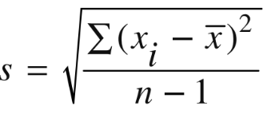
Standard Deviation
Formula:
Measured value
Sum of
Mean
Degrees of freedom
Standard deviation

Slide 25
Standard Deviation
There are four steps to solve for the standard deviation
Step 1: find the mean
Step 2: determine the deviation from the mean for each data point and square it
Step 3: calculate the degrees of freedom (n-1), n is the number of data values
Step 4: put it all together to calculate s

Slide 26
Standard Deviation
Example: let’s use the data from the tomato plant experiment
Step 1: find the mean
65 + 52 + 71 + 56 + 61 = 305/5=61
Plant | Height (mm)
1 | 65
2 | 52
3 | 71
4 | 56
5 | 61

Slide 27
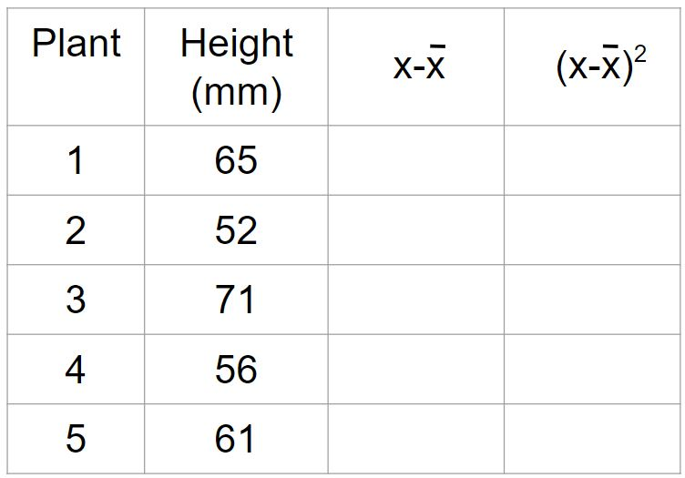
Standard Deviation
Step 2: determine the deviation from the mean for each data point and square it
Helpful to set up a data table when doing this
65-61= 4
4²=16
52-61= -9
-9²=81
71-61= 10
10²=100
56-61= -5
-5²=25
61-61= 0
0²=0

Slide 28
Standard Deviation
Step 3: determine the degrees of freedom
5-1 = 4
65-61= 4
4²=16
52-61= -9
-9²=81
71-61= 10
10²=100
56-61= -5
-5²=25
61-61= 0
0²=0

Slide 29
Standard Deviation
Step 4: put it all together to determine s
65-61= 4
4²=16
52-61= -9
-9²=81
71-61= 10
10²=100
56-61= -5
-5²=25
S=√222/4
S= 7.45
61-61= 0
0²=0
Total = 222

Slide 30
Standard Deviation
What does this mean?
Mean: 61
Standard deviation (s): 7.45
1 s would be 61 +/- 7.45 (or 53.55 through 68.45)
68% of the data should fall between 53.55 and 68.45
2 s would be 61 +/- 14.9 (or 46.1 through 75.9)
95% of the data should fall between 46.1 and 75.9
3 s would be 61 +/- 22.35 (or 38.65 through 83.35)
99% of the data should fall between 38.65 and 83.35

Slide 31
Standard Deviation
https://www.youtube.com/watch?v=09kiX3p5Vek&t=405s
Notes:
Here is a video of Mr Anderson going through standard deviation: https://www.youtube.com/watch?v=09kiX3p5Vek&t=405s

Slide 32
Standard Error of the Mean
Standard error of the mean (SEM or SE_{x}): used to determine the precision of and confidence in the mean value
Ie how well does the mean of the sample represent the true mean of the population
Based on:
Standard deviation (variability)
The number of data points
Low standard error = increase in confidence
Commonly given as +/- 2 SE (95% confidence)

Slide 33
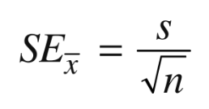
Standard Error of the Mean
Formula:
Standard deviation
Size of the sample
Standard error of the mean

Slide 34
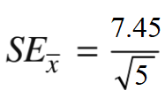
Standard Error Practice
Let’s use the data we calculated for the tomato plant experiment:
Standard deviation: 7.45
Sample size: 5
SE_{X}= 3.3
This means that each measurement varies by +/- 3.3 from the mean

Slide 35
Standard Error Practice
Standard error bars are often added to graphs
In our example, the error bars would be 61 +/- 3.33
64.33
57.67

Slide 36
Standard Error
https://www.youtube.com/watch?v=BwYj69LAQOI&t=19s
Notes:
This is a video of Mr Anderson going through standard error. My students love it! https://www.youtube.com/watch?v=BwYj69LAQOI&t=19s

Slide 37
Analyzing Error Bars
If error bars overlap, the difference is not significant
If they do not overlap, the difference may be significant
Notice that for each trial the error bars overlap. This tells us that the difference seen is not significant

