Slide 1


Slide 2
AP Biology
Throughout this course you will study core scientific principles, theories, and processes that govern living organisms and biological systems
  The course is broken down into science practices (skills) and content
Notes:
As stated by the College Board

Slide 3
AP Biology Science Practices
The Science Practices are skills that you are expected to develop and apply throughout the course
The Science Practices include:
  Concept explanation
  Analyze visual representations
  Determine scientific questions and methods
  Represent and describe data
  Perform statistical tests and data analysis
  Develop and justify scientific arguments using evidence
Notes:
As stated by the College Board

Slide 4
AP Biology Big Ideas
The content covered in AP biology is broken down into four Big Ideas
  Big Idea 1: Evolution- the process of evolution drives the diversity and unity of life
  Big Idea 2: Energetics- Biological systems use energy and molecular building blocks to grow, reproduce, and maintain dynamic homeostasis.
  Big Idea 3: Information storage and transmission- living systems store, retrieve, transmit, and respond to information essential to life processes.
  Big Idea 4: Systems interactions- Biological systems interact, and these systems and their interactions exhibit complex properties.
Notes:
As stated by the College Board

Slide 5
AP Biology Big Ideas
The Big Ideas serve as the foundation of the course and are further broken down into:
  Enduring understandings: long-term takeaways of each concept
  Learning objectives: define what a student needs to be able to do with the content knowledge in order to progress toward the enduring understandings
  Essential knowledge: describe the knowledge required to perform the learning objective
Notes:
As stated by the College Board

Slide 6
AP Biology Units
This course will cover 8 units:
  Unit 1: Chemistry of Life (Big Ideas 2-4)
  Unit 2: Cell Structure and Function (Big Ideas 1,2,4)
  Unit 3: Cellular Energetics (Big Ideas 2,4)
  Unit 4: Cell Communication and Cell Cycle (Big Ideas 2,3)
  Unit 5: Heredity (Big Ideas 1,3,4)
  Unit 6: Gene Expression and Regulation (Big Idea 3)
  Unit 7: Natural Selection (Big Ideas 1,4)
  Unit 8 Ecology (Big Ideas 1-4)
Notice: the Big Ideas in each unit overlap and build on each other
  Meaning—what you learn in each unit cannot be forgotten because it is important for other units too!
Notes:
As stated by the College Board

Slide 7


Slide 8
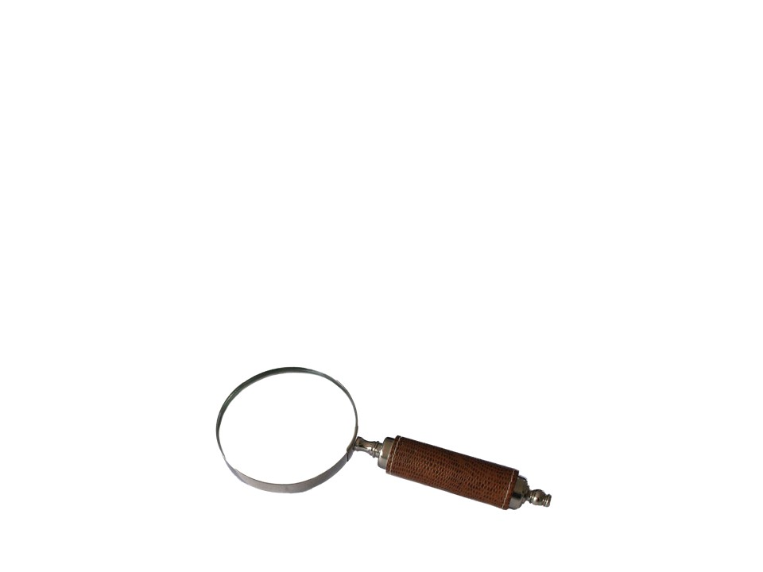
Science
At the heart of science is inquiry
  Inquiry: search for information and explanation
Two main steps:
Making observations
Forming Hypotheses

Slide 9
Making Observations
Describes natural structures and processes through observation and analysis of data
Data: recorded observations
  Qualitative: observations with senses
  Quantitative: measured using instruments
Inductive reasoning: derive generalizations based on a large number of specific observations

Slide 10
Forming Hypotheses
Hypothesis: predictions that can be tested by recording more observations or experiments
  Often heard as: “If … , then … (because…)” but does not need to be in this format
    “If”- the manipulated variable
    “Then”- the responding variable
    “Because” - optional explanation
  Results can either support or refute the hypothesis
    NEVER SAY, “The hypothesis is correct”
Deductive reasoning: specific results are derived from general premises

Slide 11
Concept Check
Every test has been easy, therefore the final will be easy
  Answer: inductive
All athletes work out. John is an athlete. Therefore, John works out.
  Answer: deductive
All organisms are made of cells, based on years of research.
  Answer: inductive
All organisms are made of cells. Dogs are organisms. Dogs are made of cells
  Answer: deductive

Slide 12
Hypotheses
Always start with a null hypothesis
  The null hypothesis (H₀) is a hypothesis which the researcher tries to disprove, reject or nullify
    The hypothesis that there is no difference between two groups of data, and the experimental observations are due to chance
      Example null hypothesis statements:
        H₀: There will be no difference in headache relief between individuals who take Tylenol and those who do not
          OR Tylenol will have no effect on headache relief

Slide 13
Hypotheses
After the null, list the alternative hypotheses
  Start with H₁ and then continue listing (H₂, H₃, etc.) as many as are necessary for the experiment
    Example alternative hypotheses:
      H₁: Tylenol will allow for relief when consumed by patients with headaches
      H₂: Tylenol will worsen symptoms when consumed by patients with headaches

Slide 14
Concept Check
Read the question below. Formulate one null and one alternative hypothesis:
Does the use of nitrogen-based fertilizer in soil affect the growth of sunflowers?
H₀:
H₁:
Nitrogen based fertilizers have no effect on the growth of sunflowers
“Because…” is optional
If nitrogen based fertilizers are used in the soil, then it will increase the growth of sunflowers (because nitrogen is necessary for leaf growth)

Slide 15
Practice
Determine a suitable null and alternative hypothesis for the question below:
Are teenagers better at geometry than adults?
H₀:
H₁:
Age has no effect on the ability to do geometry
If teenagers and adults are given geometry problems to solve, then adults will solve more problems than teenagers (because they are older and have more experience doing problems)
OR Adults may be able to solve geometry problems better than teenagers
Notice- the “if..then..” format was removed, but it still works as a hypothesis

Slide 16
Practice
Work on practice problems 2-4

Slide 17
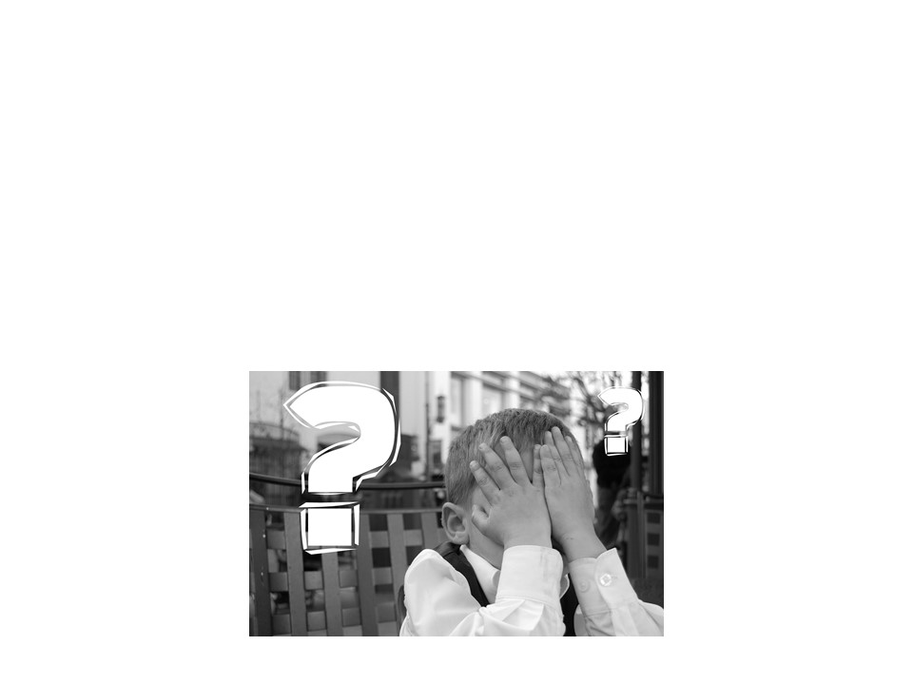
Scientific Method
Most scientific inquiries do not follow a perfectly structured form
Scientists can be working with the wrong hypothesis and have to redirect research

Slide 18

Hypothesis/Theory/Law
Hypothesis: an explanation to a question
  Tested by experiment or continued observation
  Can be disproven, but cannot be proven true

Slide 19
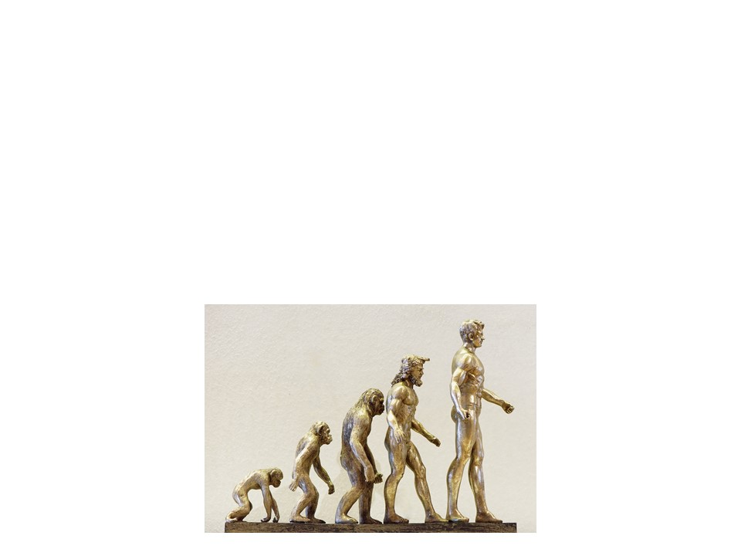
Hypothesis/Theory/Law
Theory: Summarizes a group of hypotheses
  Broader in scope
  New hypotheses can be generated from it
  Supported by massive body of evidence
  NEVER becomes a law

Slide 20

Hypothesis/Theory/Law
Scientific Law: Statement of fact usually as a mathematical formula
  ie Newton’s Law of Gravity
  Describes an observation-not “how” or “why”
  Generally accepted to be true and universal
  Basis for scientific method

Slide 21
Experiments
Start with an observation and a hypothesis
  Use control groups (+ and/or -) and experimental groups
  Well designed experiments should include:
    Independent variable (IV)
    Dependent variable (DV)
    Control group (+ and/or -)
    Constants
    # Trials (in the scientific community 3 is the minimum accepted # of trials)

Slide 22
Variables vs Constants
A variable is something that is changed in the experiment
A constant is something that does not change throughout the experiment

Slide 23
Variables vs Constants
Independent Variable: the one factor that is changed by the person doing the experiment
  Represents a quantity that is being manipulated in an experiment.
Dependent Variable: the factor which is measured in the experiment
  Represents a quantity whose value depends on how the independent variable is manipulated.

Slide 24
Variables vs Constants
Constants: all the factors that stay the same in an experiment.
  Examples depend on experiment, but could include: temperature, location, height, weight
Question: why is it important to ONLY change the independent variable?
If you measure a change in the dependent variable, you won’t know whether it is the independent variable that is causing the change.

Slide 25
Concept Check
Read the problem below and identify the independent and dependent variables:
You are washing cars to earn money. For each car you wash, you earn $10.
Independent variable: the amount of cars you wash
Dependent variable: the amount of money you receive
  The amount of money you receive DEPENDS on the number of cars you wash

Slide 26
Practice
Read the problem below and identify the independent and dependent variables:
You are interested in how stress affects heart rate in humans. You place humans under different levels of physical stress and measure their heart rate
Independent variable: physical stress exposure
Dependent variable: heart rates

Slide 27
Practice
Work on practice problems 3-5

Slide 28
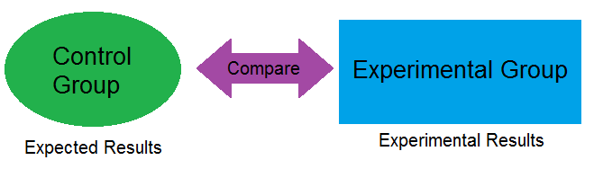
Experimental Controls

Slide 29
Think, Pair, Share
What is a bias?
How can a bias affect an experiment?
Notes:
A bias is a prejudice in favor of or against something. EVERYONE has a bias, it is unavoidable in science. Many researchers are trying to prove something by their experiments, and that in itself is a bias. This can affect an experiment because researchers can interpret or design an experiment around their bias. This is why there are blind, and even double blind studies to help eliminate bias in experiments.

Slide 30
Control Groups
Controls are essential elements of an experiment
  They help eliminate experimental errors and biases of researchers.
  Results of the control experiments validate statistical analysis of the experiment
    Statistical analysis is necessary to determine whether or not data is significant (we will discuss this more later)
  Reliability of the experiment increases
Note: controls are NOT constants

Slide 31
Types of Control Groups
There are two types of controls: positive and negative

Slide 32
Positive Controls
Group not exposed to the experimental treatment or independent variable
  But it IS exposed to a treatment known to produce the expected effect
  Ensures that there is an effect when there should be an effect
    If the positive control does not produce the expected result, there may be something wrong with the experimental procedure

Slide 33
Negative Controls
Group not exposed to any treatment or exposed to a treatment that is known to have NO effect
Ensure that there is no effect when there should be no effect.
  Group where nothing is expected to happen
Note: Experiments do not need to contain both a positive and negative control

Slide 34
Using Positive Controls
Scientists use positive controls when they are trying to induce a positive result
  Example: if there is a new drug to treat headaches, Tylenol can be used as a positive control to show that headaches can be relieved in the patients being tested

Slide 35
Practice
A researcher wants to test the effect of a new antibiotic on a strain of bacteria
How would the researcher know the new antibiotic (experimental group) is actually effective?
Use an established antibiotic that is known to work (positive control group)
If the experimental groups fail, but the positive control is successful, it is likely that the tested antibiotics are ineffective.

Slide 36
Using Negative Controls
A negative control can be a way of setting a baseline
  Used to ensure that no confounding/outside variable has affected the results, or to factor in any likely sources of bias
    It uses a sample that is not expected to work
    Or the group is not exposed to anything
      Example: if there is a new drug to treat headaches, a placebo can be used as a negative control

Slide 37
Practice
A researcher wants to test the effect of caffeine on heart rate
Researcher will give negative control group a treatment that is known to have no effect on heart rate
Water is known to have no effect on heart rate with consumption
If the water affects heart rate in the negative control group then there must be another variable affecting heart rate or the water is contaminated

Slide 38
Practice
You want to design an experiment to determine if a new drug has an impact on lowering blood pressure. Test subjects with high blood pressure are given a new medication in pill form. The percentage of patients whose blood pressure decreased is measured. What are good positive and negative controls?
  Negative control: placebo pill (or substance that has no effect)
  Positive control: Test subjects are given a drug that is known to reduce blood pressure.
Notes:
For the negative control: If the group receiving the new drug shows improvement, it needs to be compared to the placebo group. The treatment is only effective if the treatment group shows more improvement than the placebo group.

Slide 39
Practice
You believe that when someone drinks a soda, their heart rate will increase. You set up an experiment, using various sodas, and various amounts of consumption and then measure the heart rate of the individuals. What are good positive and negative controls?
  Negative control: water
  Positive control: energy drink

Slide 40
Practice
Work on practice problems 3-4

